Slide 1


LIMU-BERT: Unleashing the Potential of Unlabeled Data for IMU Sensing Applications
Huatao Xu, Pengfei Zhou, Rui Tan, Mo Li, Guobin Shen

Slide 2


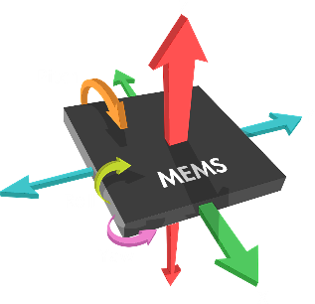
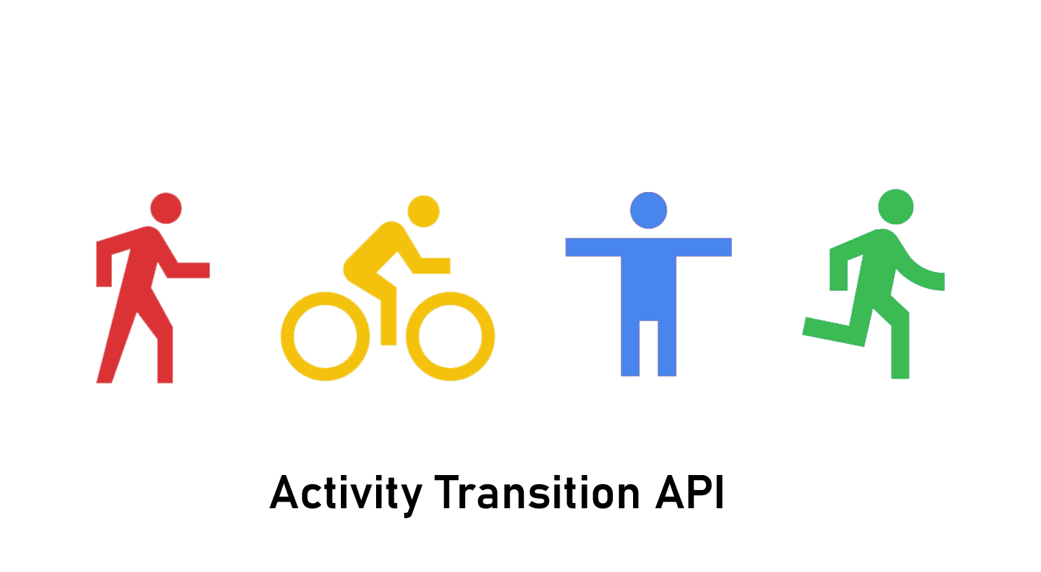


Background
IMU sensors in mobile devices:
Accelerometer
Gyroscope
Magnetometer
Potential applications:
Human activity recognition
Human computer interaction
Indoor localization

Slide 3
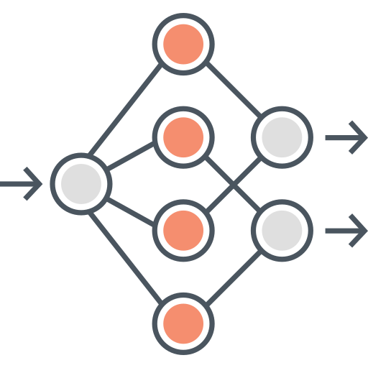

Background
Supervised representation learning for IMU sensing
Limitation: it requires a large amount of labeled data!

Slide 4

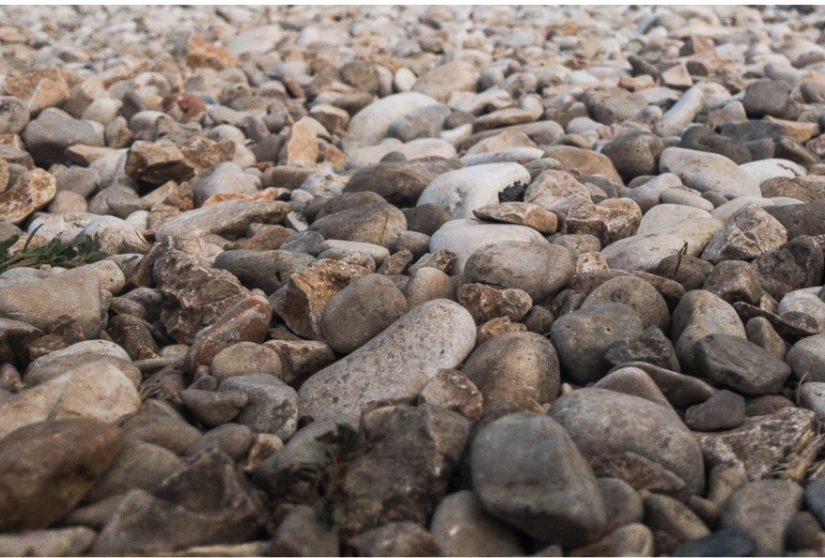
Motivation
Labeled data:
Costly
Hard to collect
Unlabeled data:
Cheap
Easy to collect
Can unlabeled data help IMU sensing?
https://speech.ee.ntu.edu.tw/~hylee/dlhlp/2020-spring.html

Slide 5
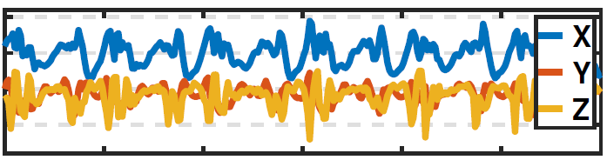
Motivation
Transformation-based: TPN [1] learns representations by recognizing the transformations applied to the raw input signal.
Noised
Shared
CNN
Noise Task Head
Noised / Not Noised
Scaled
Scaled Task Head
Scaled / Not Scaled
Accelerometer
Rotated
Rotated Task Head
Rotated / Not Rotated
2
Dimension
Reduction
2
1
1
3
3
Data Space
Feature Space
[1] Saeed, Aaqib, et al. "Multi-task self-supervised learning for human activity detection." Ubicomp 2019.
Notes:
It is indeed a dimensionality-reduction method removing the redundant information. The performance is not stable in the multiple sensor cases.

Slide 6
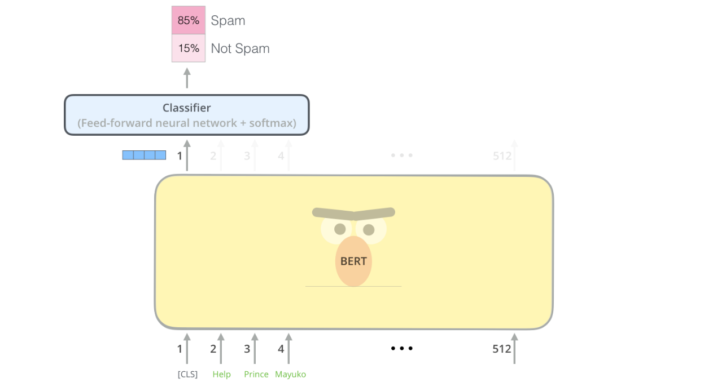
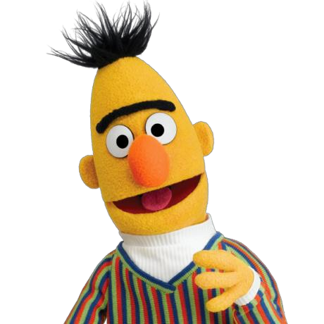
Motivation
Self-supervised learning methods:
Contrastive-based
GAN-based
Autoencoder-based:
BERT [3]: learn representations from unlabeled text data.
There are large amounts of text (e.g., Wikipedia, news, books).
There are specific patterns in text (e.g., grammar, context, word meaning).
The patterns can help many NLP applications.
[1] Devlin, Jacob, et al. "Bert: Pre-training of deep bidirectional transformers for language understanding." arXiv preprint arXiv:1810.04805 (2018).
[2] https://towardsdatascience.com/how-to-do-text-binary-classification-with-bert-f1348a25d905

Slide 7
Our idea
Observations for IMU-based sensing scenarios:
There are abundant IMU data.
There are specific patterns in IMU data (e.g., periodical changes).
The patterns can help sensing applications (e.g., activity recognition).
Introduce BERT to learn representations from IMU sensory data:
IMU + BERT = LIMU-BERT

Slide 8
BERT - Training
Pre-training phase: learn representations from unlabeled text data.
MLM
Classifier
BERT
Welcome To ACM SenSys
Mask
Welcome [MASK] ACM SenSys
Dictionary

Slide 9
BERT - Training
Pre-training phase: learn representations from unlabeled text data.
MLM
Classifier
NSP
Classifier
BERT
Sentence-A
Sentence-B
Connect
[CLS] Sentence-A [SEP] Sentence-B…
Dictionary

Slide 10
BERT - Usage
Fine-tuning phase: learn to accomplish a task with labeled data.
Task
Classifier
Sentence-level task:
Input: sentence
Output: class
Application: sentiment analysis
BERT
(Fine-tuned)
Positive / Negative
[CLS] I like this T-shirt…
Dictionary

Slide 11
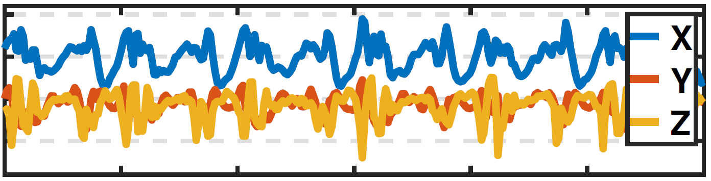
Challenges
From text to IMU data.
MLM
Classifier
NSP
Classifier
Text
IMU
A B C D E F
BERT
Welcome To ACM SenSys
Sentence-A
Sentence-B
1. Continuous variables
Mask
Connect
Welcome [MASK] ACM SenSys
[CLS] Sentence-A [SEP] Sentence-B…
Dictionary

Slide 12
Challenges
From text to IMU data.
MLM
Classifier
NSP
Classifier
Text
IMU
A B C D E F
BERT
Welcome To ACM SenSys
Sentence-A
Sentence-B
1. Continuous variables
2. Multi-modal
Mask
Connect
Welcome [MASK] ACM SenSys
[CLS] Sentence-A [SEP] Sentence-B…
Dictionary

Slide 13
Challenges
From text to IMU data.
MLM
Classifier
NSP
Classifier
Text
IMU
A B C D E F
BERT
Welcome To ACM SenSys
Sentence-A
Sentence-B
1. Continuous variables
2. Multi-modal
Mask
Connect
3. Motion features
Welcome [MASK] ACM SenSys
[CLS] Sentence-A [SEP] Sentence-B…
Dictionary

Slide 14
Challenges
From text to IMU data.
MLM
Classifier
NSP
Classifier
Text
IMU
A B C D E F
BERT
Welcome To ACM SenSys
Sentence-A
Sentence-B
1. Continuous variables
2. Multi-modal
Mask
Connect
3. Motion features
Welcome [MASK] ACM SenSys
4. Efficiency
[CLS] Sentence-A [SEP] Sentence-B…
Dictionary

Slide 15
Design
Adapt BERT to IMU data.
MLM
Classifier
1. Continuous variables
2. Multi-modal
BERT
Normalization
3. Motion features
Mask
4. Efficiency

Slide 16
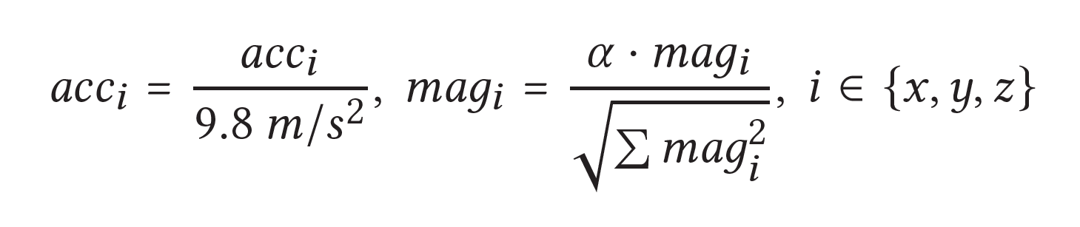
Normalization
IMU sensors have varied distributions:
Previous solutions: mean-variance, min-max, magnitude, FFT
They lose important information!
Our solution:

Slide 17
Design
Adapt BERT to IMU data.
MLM
Classifier
1. Continuous variables
Fusion
2. Multi-modal
BERT
3. Motion features
Mask
4. Efficiency

Slide 18
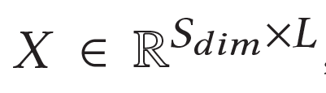
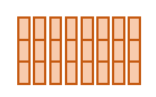
Fusion
Align data: IMU readings are naturally well-aligned.
Accelerometer
Gyroscope
Magnetometer
Time Index

Slide 19
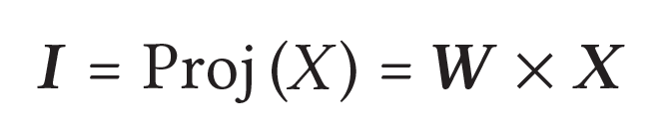
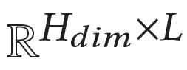
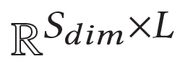
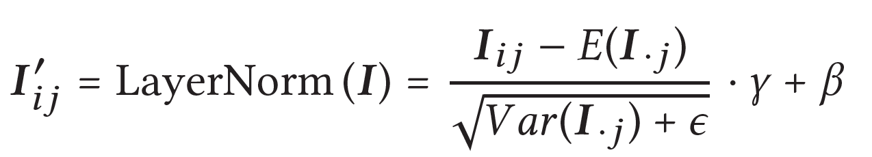
Fusion
Fuse data: expand feature space.
Fuse data: normalize expanded features.

Slide 20
Design
Adapt BERT to IMU data.
MLM
Classifier
1. Continuous variables
Training
Method
2. Multi-modal
BERT
3. Motion features
Mask
4. Efficiency

Slide 21
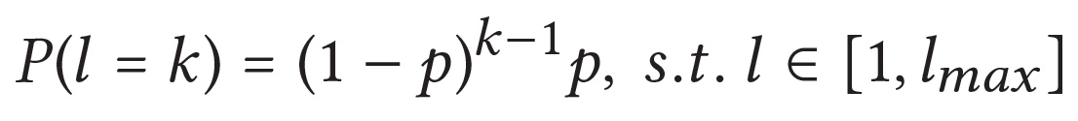
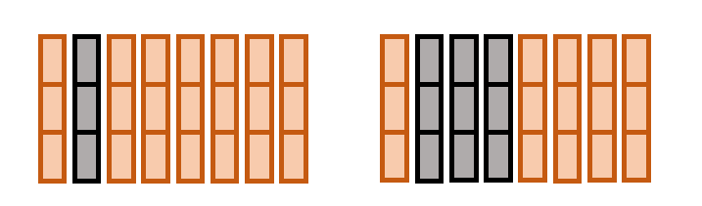
Training method
LIMU-BERT:
Adopt MLM and skip NSP.
Reconstruction task is treated as a regression problem.
Mask N continuous readings, which is sampled from a geometric distribution.
BERT
LIMU-BERT

Slide 22
Design
Adapt BERT to IMU data.
MLM
Classifier
1. Continuous variables
2. Multi-modal
BERT
3. Motion features
Mask
Lightweight
Model
4. Efficiency

Slide 23
Lightweight Model
LIMU-BERT should run on mobile devices:
Down-sample to reduce the sequence length. [20Hz]
Reduce feature dimension. 1024 -> 72
Adopt cross-layer parameter sharing. 4 blocks -> 1 block
Block-1
Block-2
Block-3
Block-4
Share parameters

Slide 24
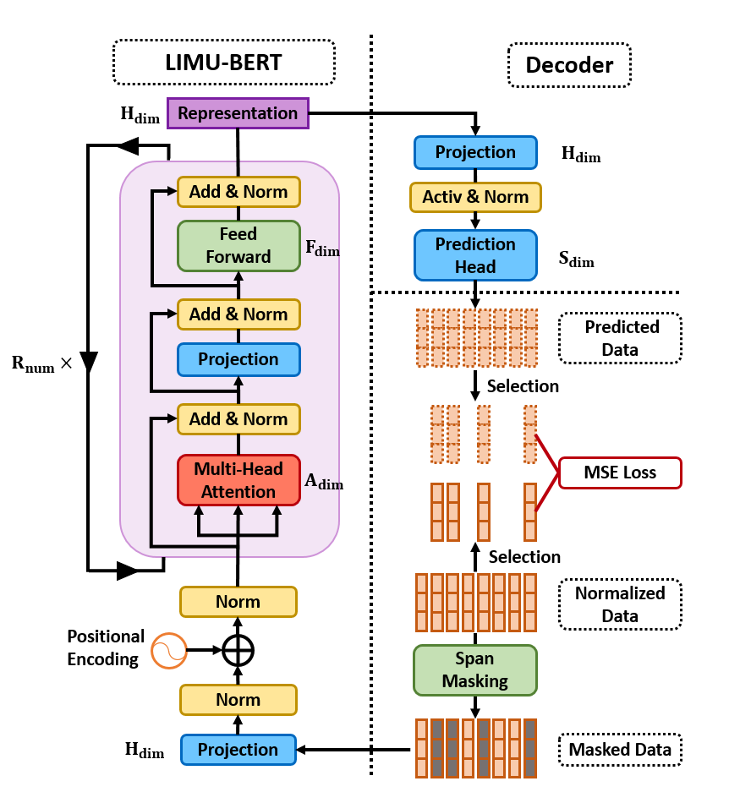
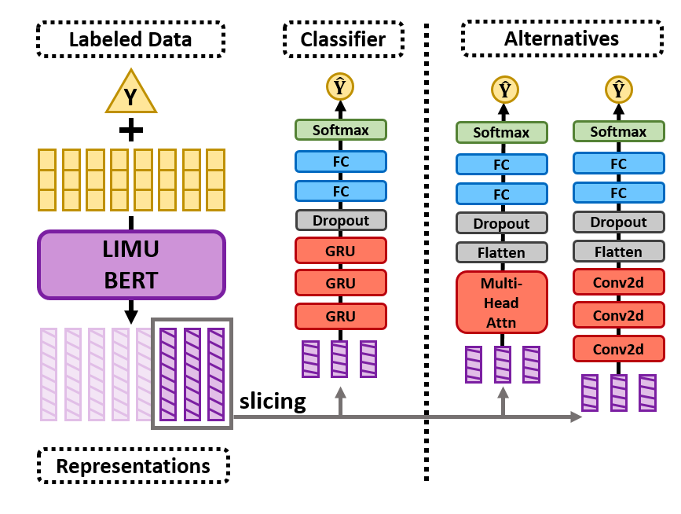
Design - Workflow
Self-supervised learning phase: Learn representations.
Supervised learning phase: Learn to accomplish task.

Slide 25
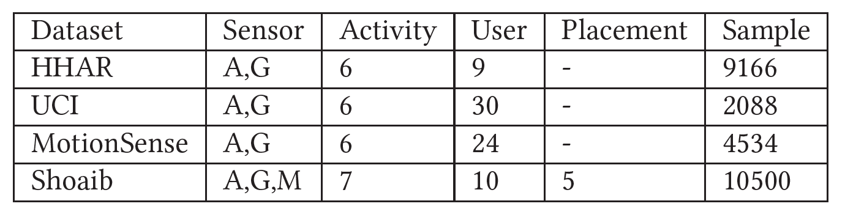
Evaluation
Datasets: HHAR, UCI, MotionSense, Shoaib
Dataset Partition:
Training set (80%): train LIMU-BERT
Labeling set (1%): train classifier
Validation set (10%): select model
Test set (10%): evaluate model

Slide 26
Evaluation
Models in comparison:
LIMU-GRU: LIMU-BERT + GRU classifier
DCNN [IJCAI’15]
DeepSense [WWW’17]
TPN [Ubicomp’19]
R-GRU: raw data + GRU classifier
Applications:
Human activity recognition (HAR).
Device placement classification (DPC).
Metric: Accuracy and F1-score

Slide 27
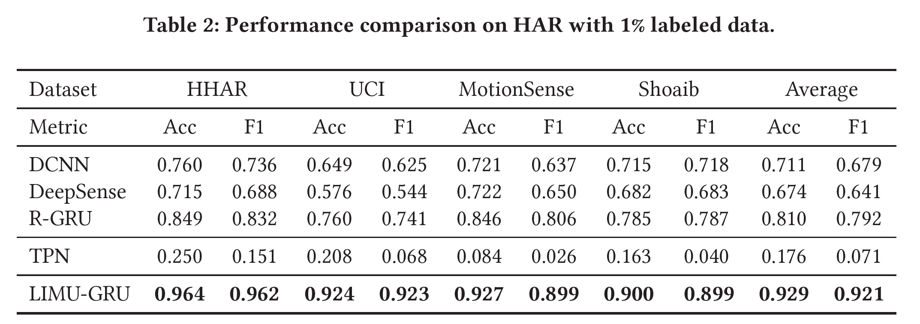
Evaluation - HAR
Overall performances with 1% labeled samples.

Slide 28
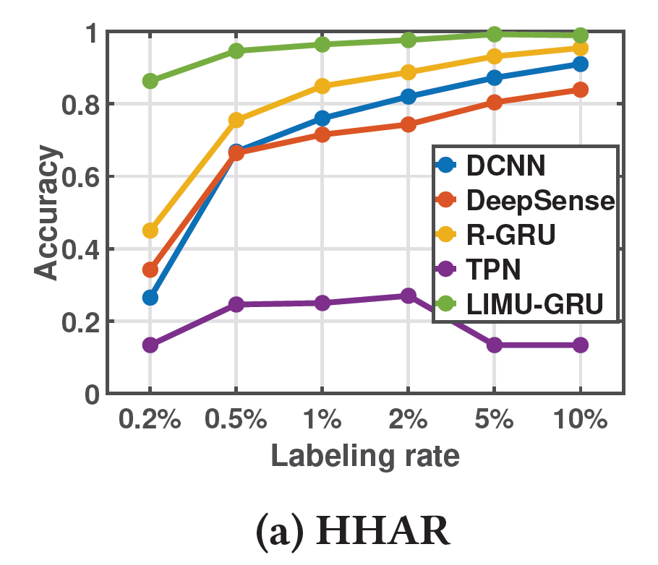
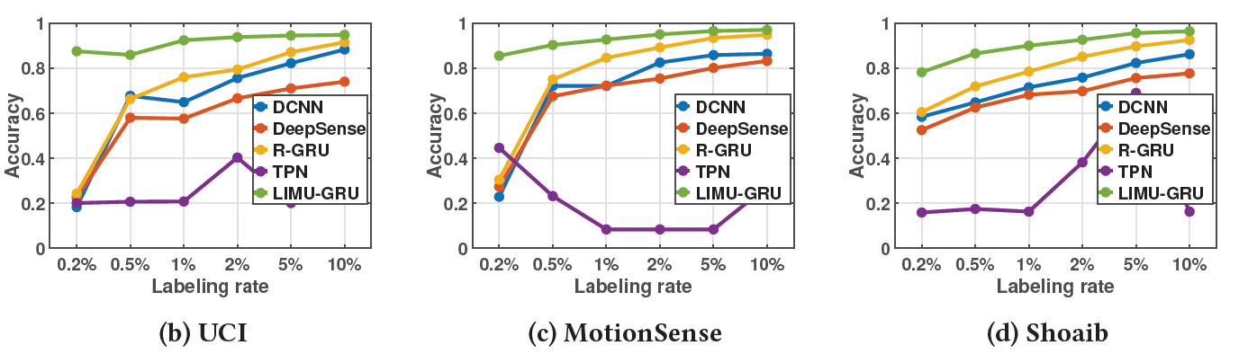
Evaluation - HAR
Varying number of labeled samples.

Slide 29
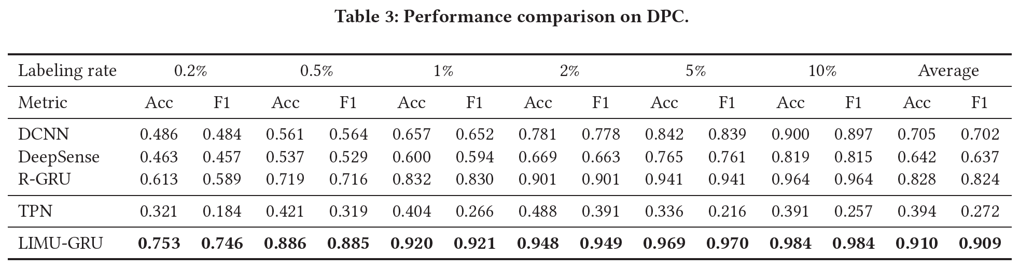
Evaluation - DPC
Overall performances.

Slide 30
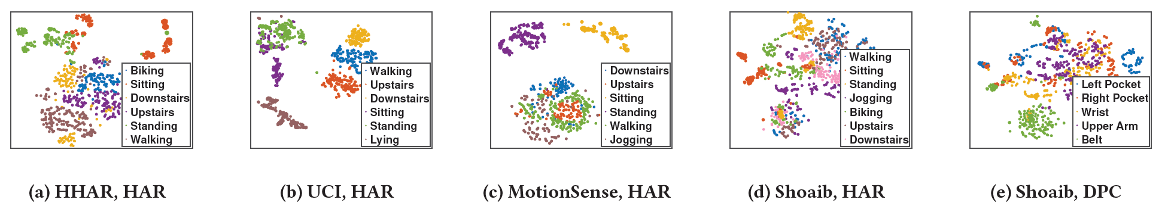
Micro-benchmark
Representation visualization with t-SNE.

Slide 31
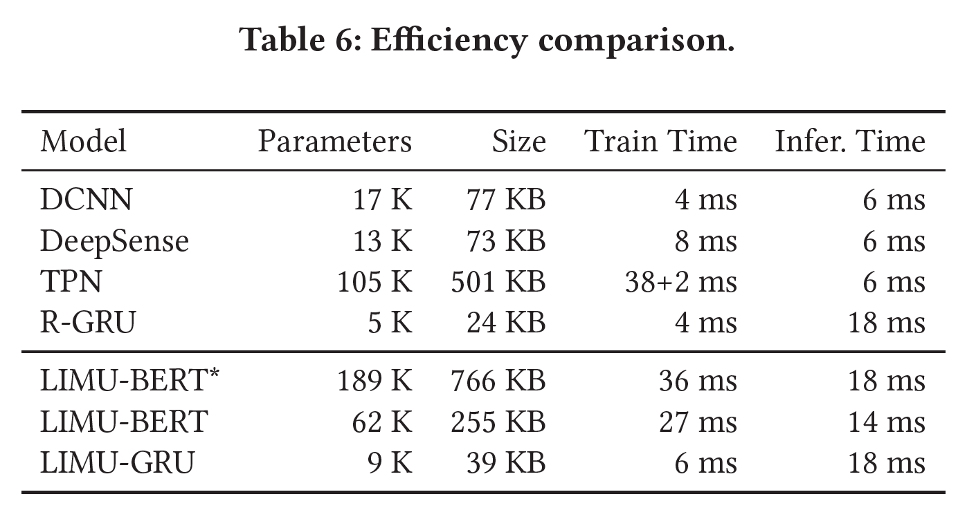
Micro-benchmark
Computation overhead:
Training time:
server
Inference time:
Samsung Galaxy S8

Slide 32
Conclusion
We present LIMU-BERT, a lightweight representation learning model for mobile IMU sensor data:
Extracts effective and generalized features.
Does not require labeled data.
Lightweight
Extensive experiments show LIMU-BERT can significantly boost the performances of down-stream models with few labeled samples.
Source code:
https://github.com/dapowan/LIMU-BERT-Public

Slide 33
Thank you!
Q&A

Slide 34
Backup Slides

Slide 35
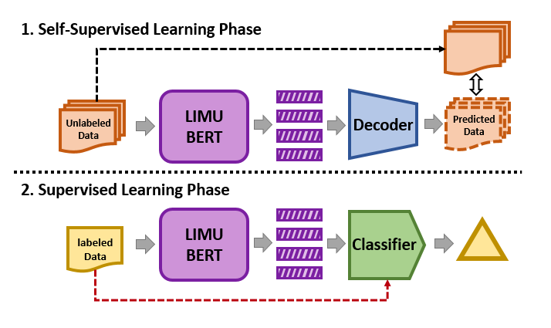
Overview
Self-supervised learning phase: learn the general representations.
Supervised learning phase: accomplish specific tasks.

Slide 36
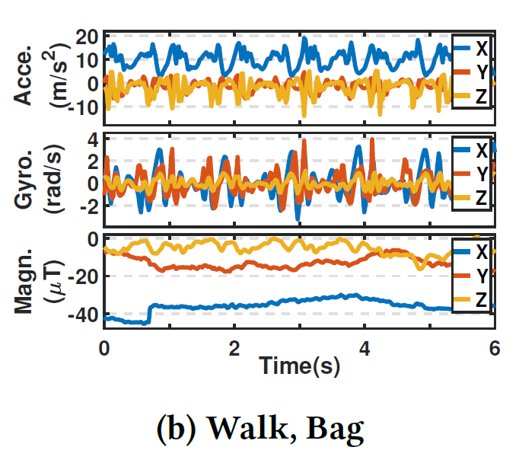
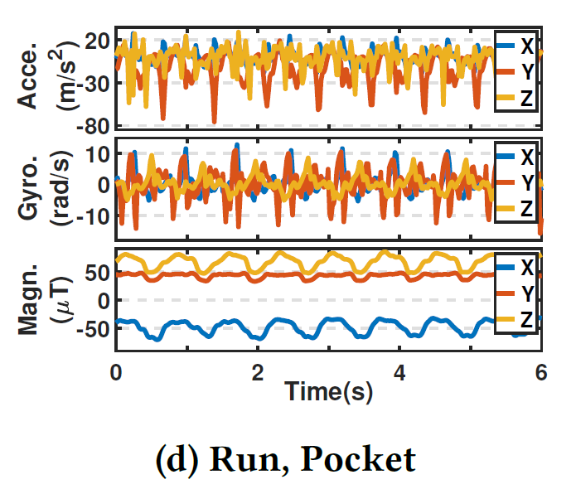
Normalization
IMU sensors have varied distributions:
Previous solutions: mean-variance, min-max, magnitude, FFT

Slide 37
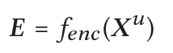
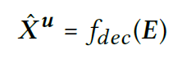
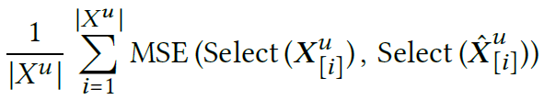
Design - Workflow
Self-supervised learning phase:
LIMU-BERT:
Decoder:
Loss:

Slide 38
Design - Workflow
Supervised learning phase:
Slicing for high granularity.
Lightweight classifier.

Slide 39
Micro-benchmark
Impact of input sensors.
Impact of normalization method.
Impact of mask approach.
Impact of representation dimension.
Impact of dataset.

Slide 40
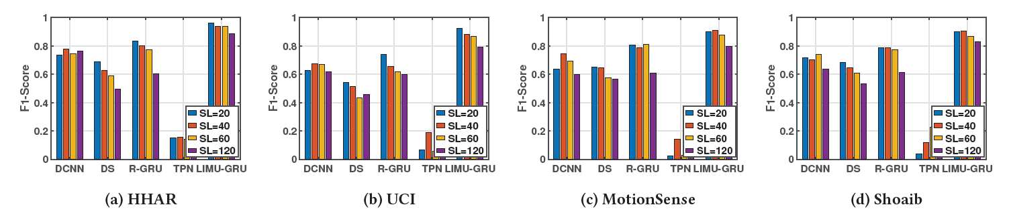
Evaluation - HAR
Varying window size / sequence length(SL).

Slide 41
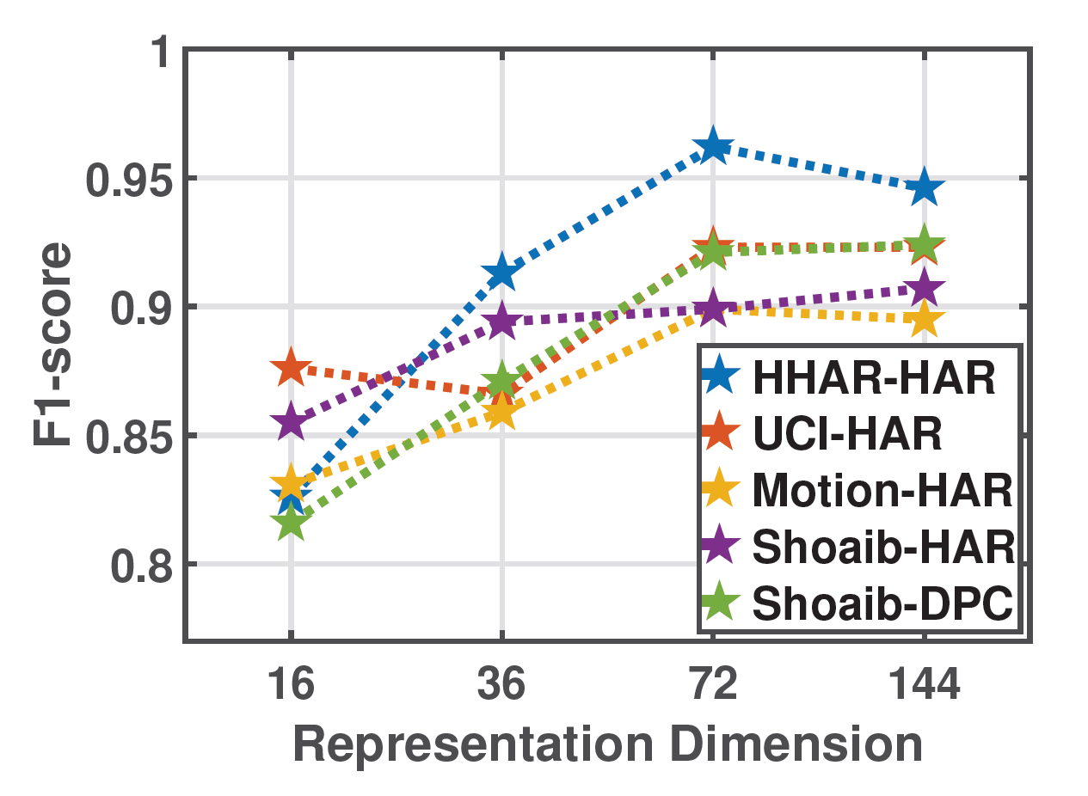
Micro-benchmark
Impact of representation dimension.

Slide 42
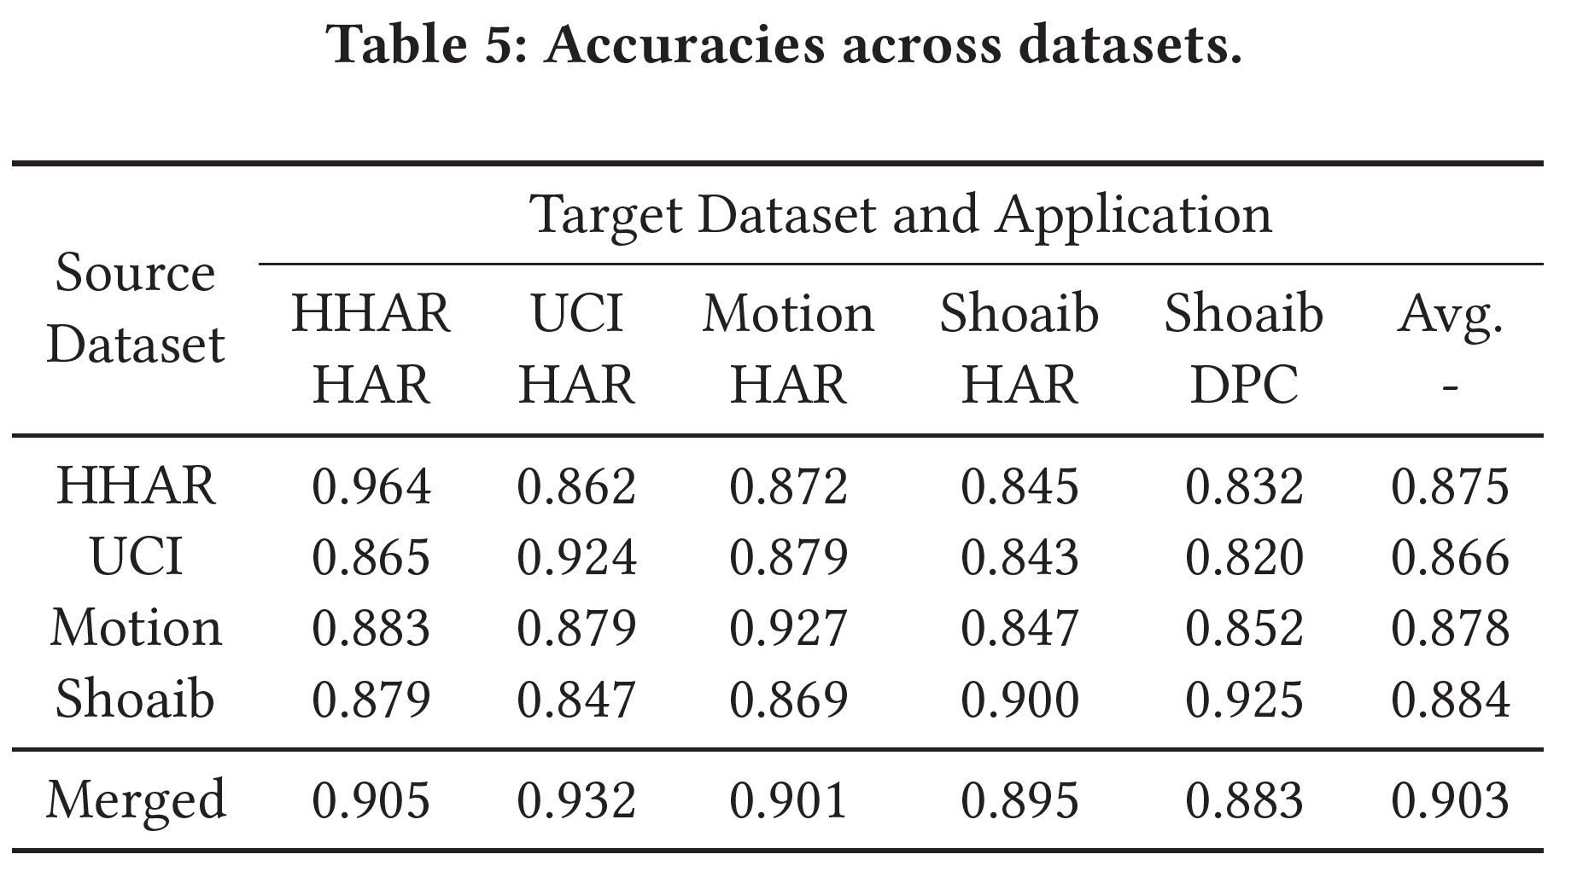
Micro-benchmark
Impact of dataset.

Slide 43
Discussion
Model transferability.
Irrelevant event detection.
User privacy.

Slide 44
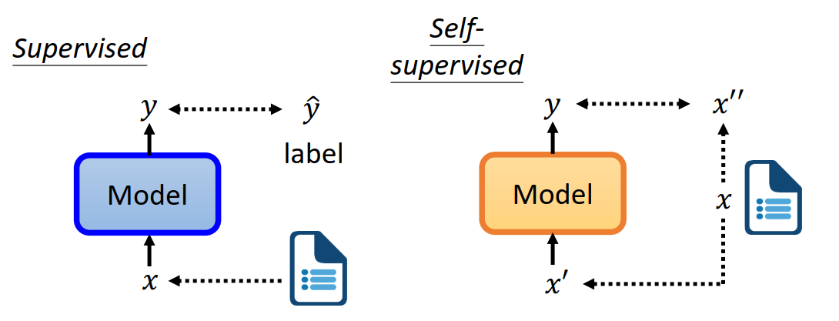
Self-supervised Learning
Supervised VS Self-supervised
Supervised: learn the mapping between x and y
Self-supervised: learn the relations among x
https://speech.ee.ntu.edu.tw/~hylee/dlhlp/2020-spring.html

Slide 45

BERT
Bidirectional Encoder Representations from Transformers
Goal: Extract embedding from unlabeled data.
Idea: Bidirectional encoding with attention.
Vaswani, Ashish, et al. "Attention is all you need." Advances in neural information processing systems. 2017.

Slide 46
BERT - Training
Pre-training phase: learn representations from unlabeled text data.
1. Mask Language Model (MLM)
2. Next Sentence Prediction (NSP)
MLM
Classifier
NSP
Classifier
To
YES/NO
BERT
Welcome [MASK] ACM SenSys
[CLS] Welcome to ACM SenSys [SEP] Embedded Networked …
Devlin, Jacob, et al. "Bert: Pre-training of deep bidirectional transformers for language understanding." arXiv preprint arXiv:1810.04805 (2018).

Slide 47
BERT - Usage
Fine-tuning phase: learn to accomplish a task with labeled data.
Task
Classifier
Positive / Negative
Sentence-level task:
Input: sentence
Output: class
Application: sentiment analysis
BERT
(Fine-tuned)
[CLS] I like this T-shirt
Devlin, Jacob, et al. "Bert: Pre-training of deep bidirectional transformers for language understanding." arXiv preprint arXiv:1810.04805 (2018).

Slide 48
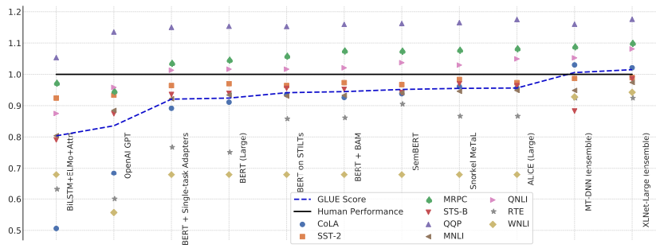
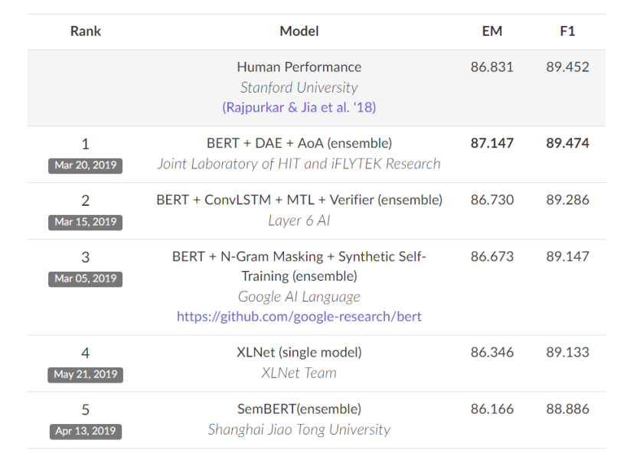
BERT
Push the performances to higher levels in wide range of NLP tasks.
https://speech.ee.ntu.edu.tw/~hylee/dlhlp/2020-spring.html

Slide 49
BERT
Learn embedding from context
bird
… apple … tree …
apple
pear
1
fish
… orange … tree …
2
… pear … tree …
orange
3
Apple
Amazon
Facebook
Target Token
Context

Slide 50
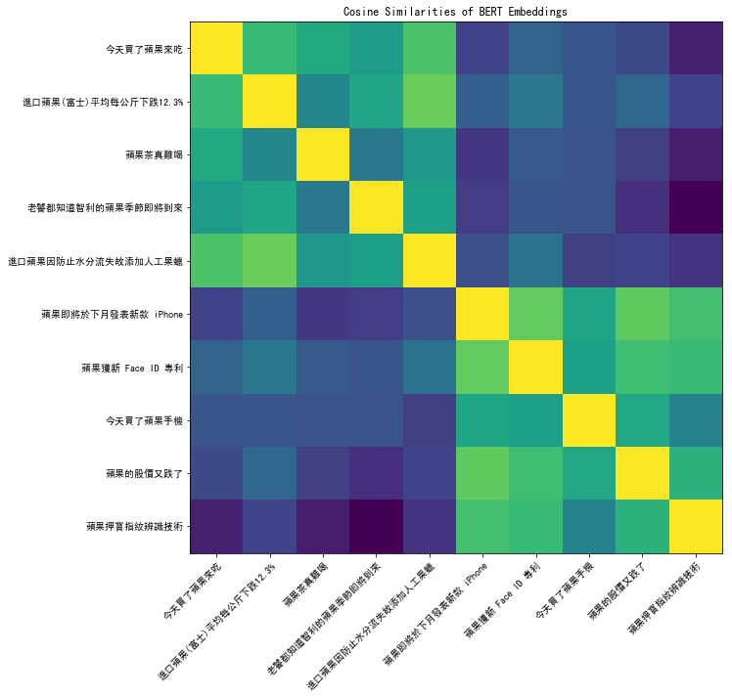
BERT
Apple juice vs Apple stock
https://speech.ee.ntu.edu.tw/~hylee/dlhlp/2020-spring.html

